Slide 1
Totally Not About ChatGPT and Google Stock Prices
Sherlock Langevine, Erick Ramirez
DATASCI 112
Notes:
Our hy

Slide 2
Question:
Can we use the sentiments of news articles regarding ChatGPT to predict Google stock prices?

Slide 3
Data Collection

Slide 4
Data Collection
News API (newsapi.org)
Top 50 most popular news sites in the US (https://datawrapper.dwcdn.net/iusxr/1/)
Searched for articles pertaining to ChatGPT
Added articles to DataFrame; title, description, content
Stock Data API (api.stockdata.org)
Google Stock DataFrame

Slide 5
Data Cleaning

Slide 6

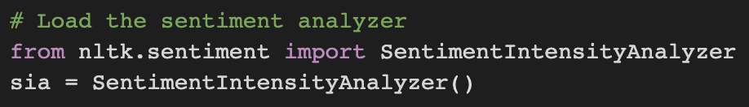
Data Cleaning
Stock Data
Renamed dates to follow following format: MM/DD
Set index to the new date
News Data
Cleaned articles that perhaps have no title, description, or content
Analyzed the sentiment (neg, neu, pos) of the title, description, and content for each article
concatenate to DF
Renamed name of News Site from provided API
Added ranking and million-views columns to DF
Merged News data and Stock data

Slide 7
Data Exploration

Slide 8
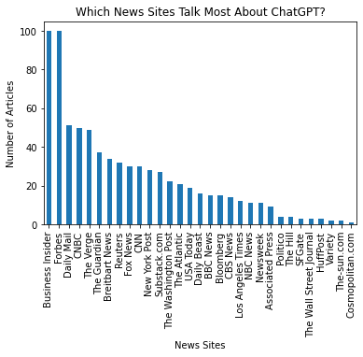
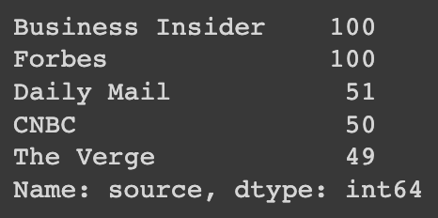
ChatGPT in the News

Slide 9
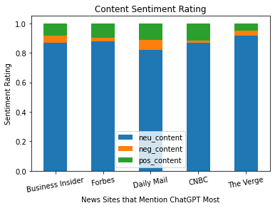
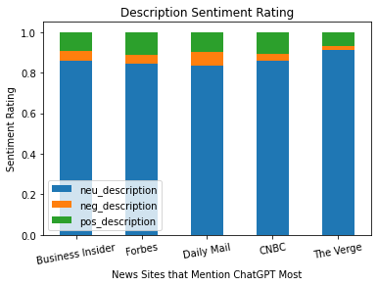
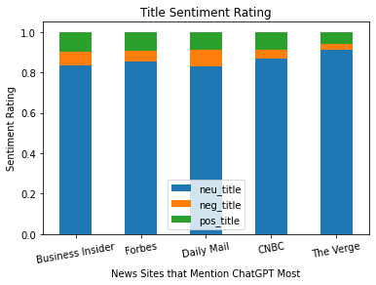
Sentiment Ratings Grouped By Text
Notes:
Mostly neutral
Similar across the board

Slide 10
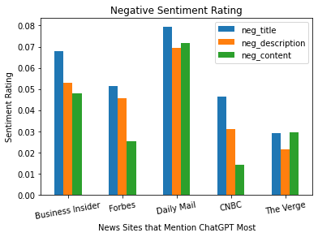
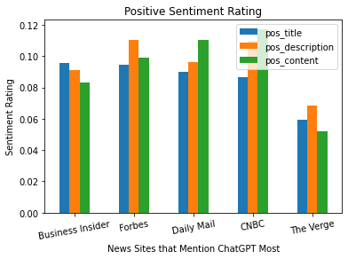
Sentiment Ratings Grouped By Sentiment
Notes:
More negative in titles less neg in content, neutrals overal, pos fluctuates

Slide 11
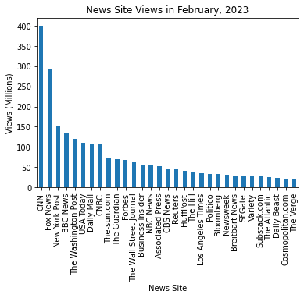
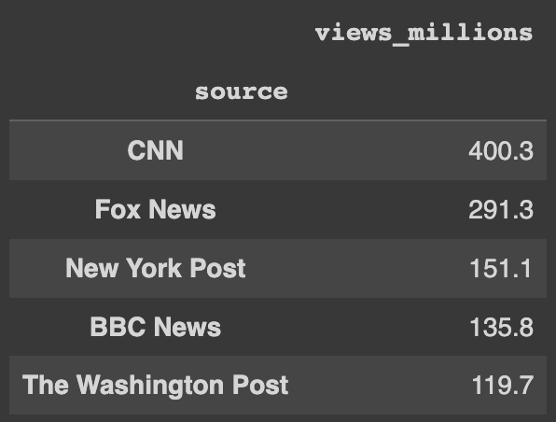
Most Popular News Sites

Slide 12
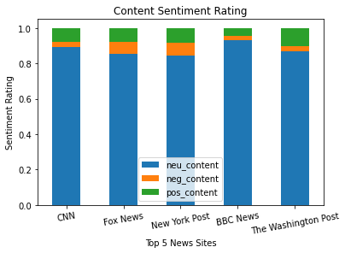
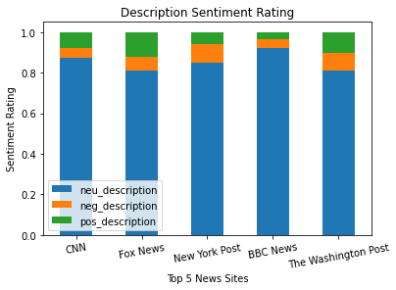
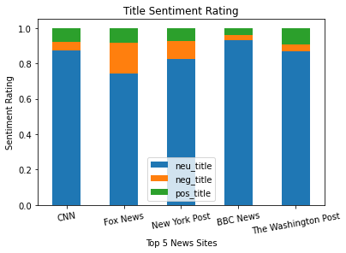
Sentiment Ratings Grouped by Text

Slide 13
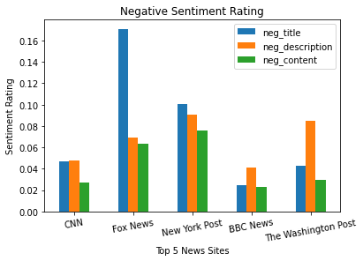
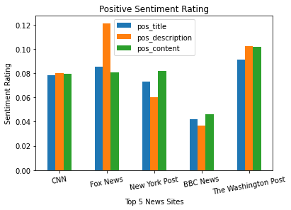
Sentiment Ratings Grouped by Sentiment
Notes:
Titles tend to be more negative, pos fluctuates

Slide 14
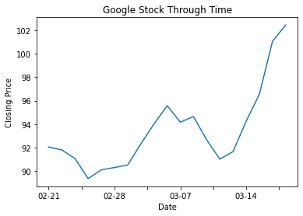
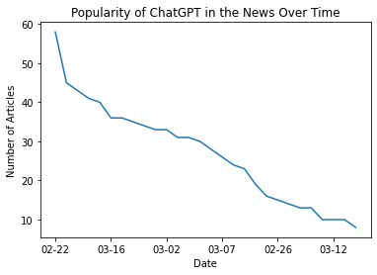
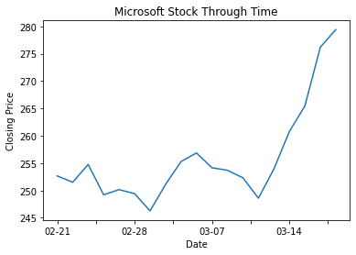
Stock Data Through Time

Slide 16
Machine Learning
Goal: How well can we predict Google stock price given an article’s sentiments?
Primary Features: opening price
Other Features: sentiments, title/description/content, source, ranking, views
Predicting quantitative value: use regression.

Slide 17
RandomForestRegressor()
Features | Cross Validation Score
sentiments, open price, views, source | 6.197399514813221
sentiments, open price, views | 6.214605021563399
Title, description, content, open price | 6.187375874626928
Source, open price, views | 6.225253077501636

Slide 18
LinearRegressor()
Features | Cross Validation Score
Sentiments, open price, views, source | 450.50951515676996
Sentiments, | 433.2474648280323
Title, description, content, open price | 3.9515028227840183
Open price, views, source | 2.536966210534873

Slide 19
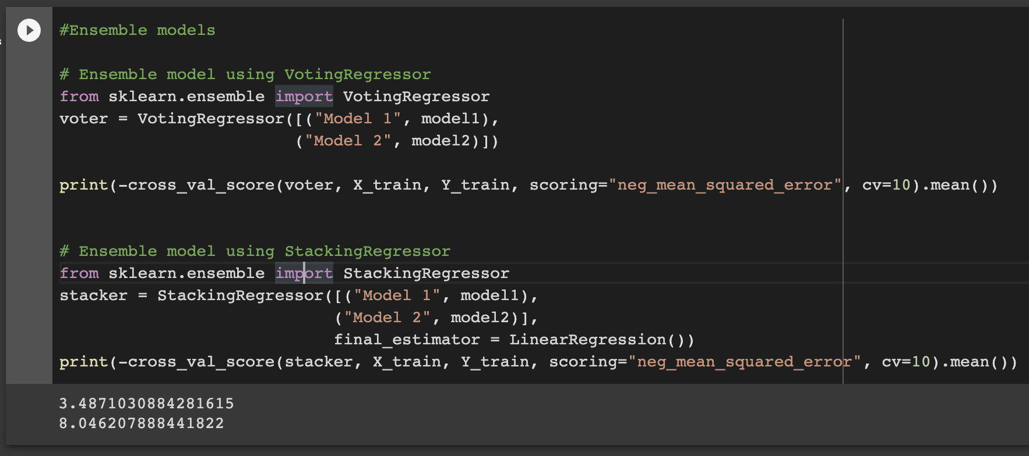
Ensemble

Slide 20
Questions?

